Slide 1

Animal Shelter Capstone Project
By Gabriel Castillo

Slide 2
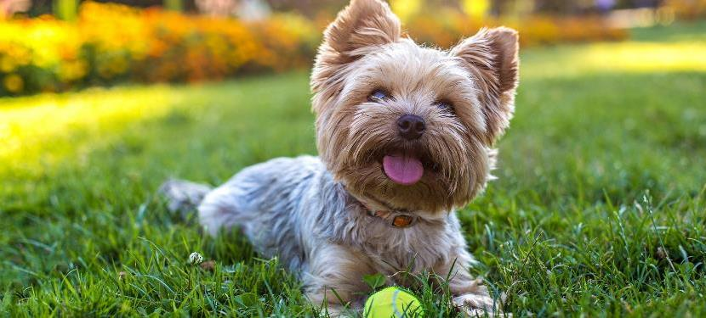
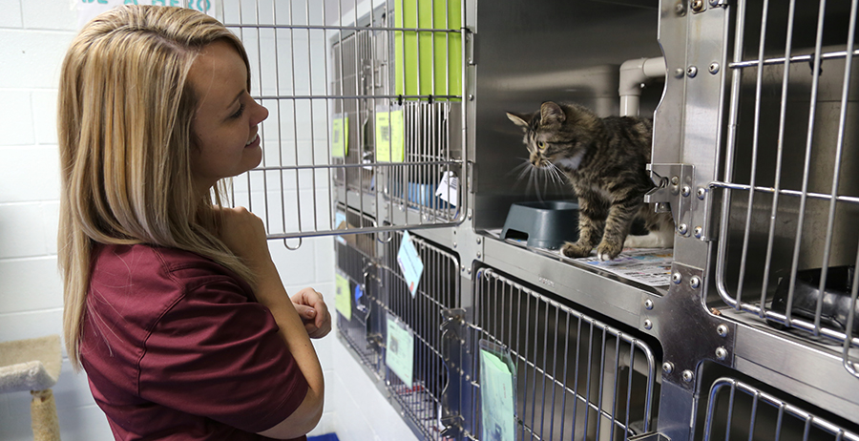
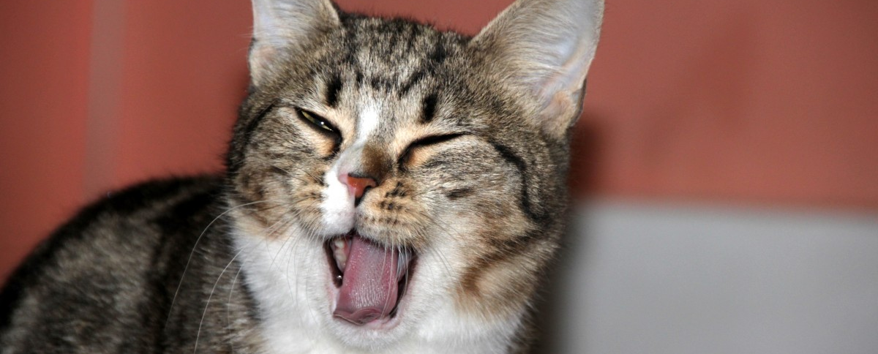
My Datasets:
OAS Animal Pathway Dataset:
Breed
Sex
Animal type
Age
Size
Color
OAS Animal Impound:
Intake type
Outcome
Entry/Exit Time of the animal
Location (longitude, latitude)
Joined by Animal ID
This Photo by Unknown Author is licensed under CC BY-SA

Slide 3
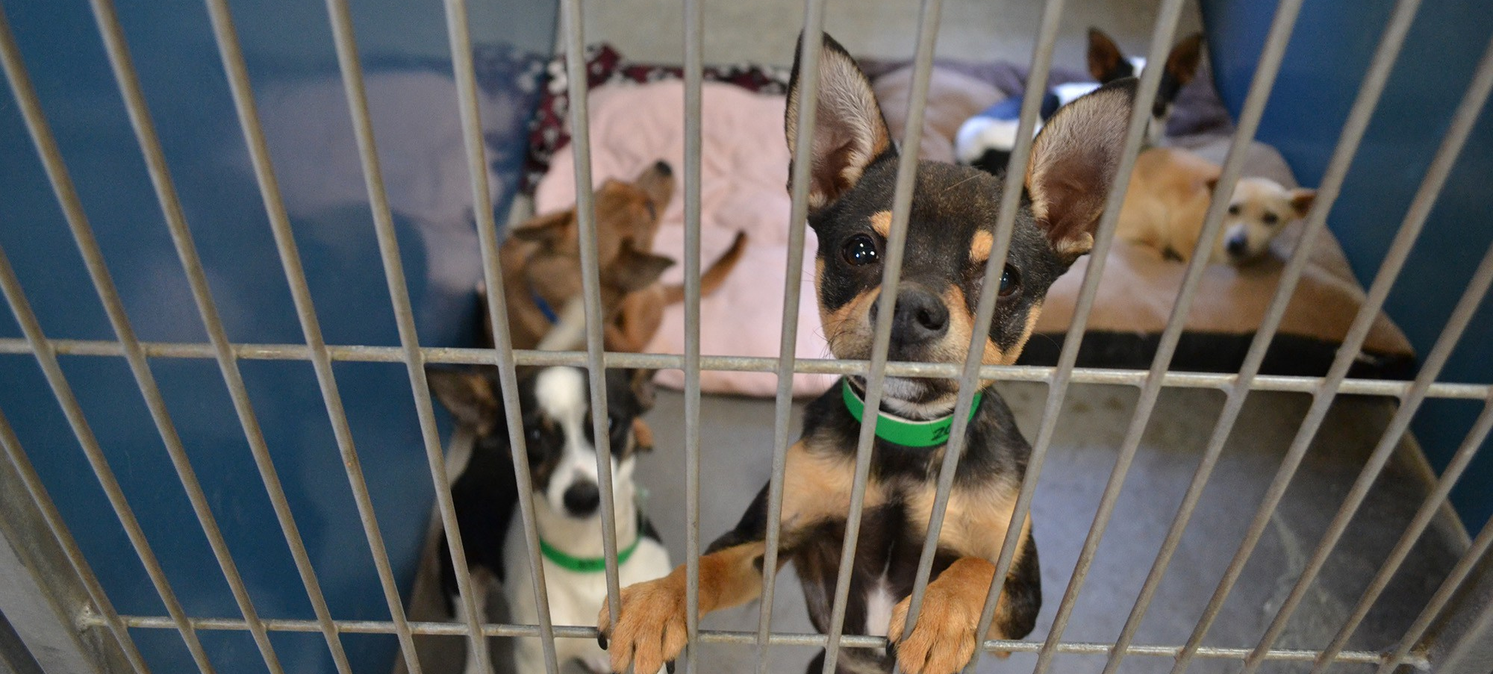

Goals:
The goal of the capstone project is to:
Which factors have the greatest influence on animal outcomes
Providing valuable information to pet owners surrendering their pets and shelters to reduce impounds and improve adoption rates.
This Photo by Unknown Author is licensed under CC BY-SA

Slide 4
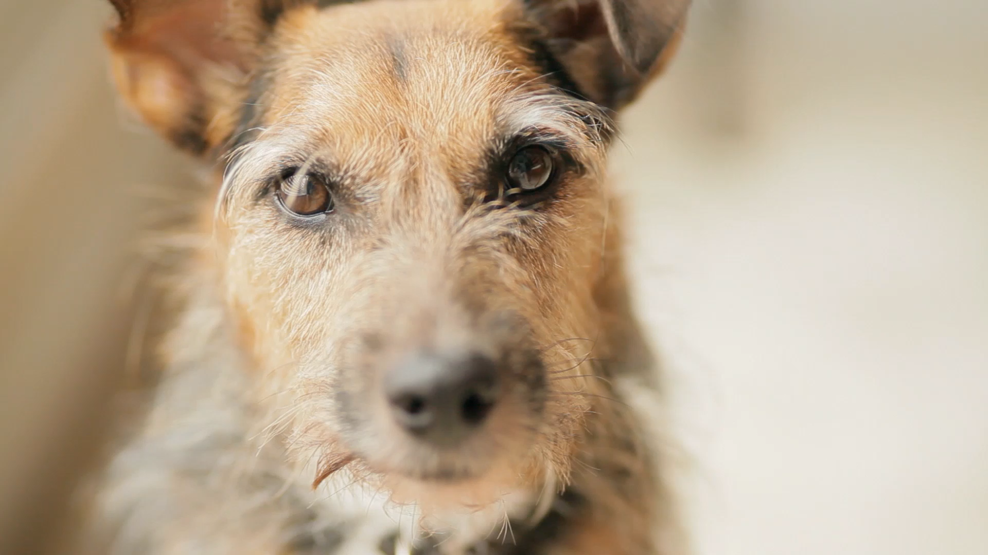
Research Questions:
What are the most common types of animals entering the shelter system?​
How long do animals typically stay in the shelter?​
What percentage of animals are adopted vs. euthanized vs. transferred?​
What breeds are most frequently impounded?​
Are certain times of the year associated with higher intake rates?​
Are certain intake reasons more likely to lead to euthanasia?​
Does age affect euthanizing likelihood?​
What are the most common reasons for intake?​
Which shelters receive the most animals?​
Does the animal bite history affect its outcome?​

Slide 5

Tools:
I will be using R for the first part of my project due to its statistical analysis and easy data visualization.
The other program I will be using is Tableau to create the GIS map for my project and a dashboard.

Slide 6
Summary of data cleaning/pre-processing:
The cleaning was fairly simple:
involving renaming columns, which required the removal of periods and underscores.
Creating a Year/month variable
Creating mini dataframes before every graph so as not to affect the main combined datasets
Tricky Cleaning:
The arrival and departure dates are set to POSIT time variables, and the difftime function is used to compute the difference between them in days.

Slide 7
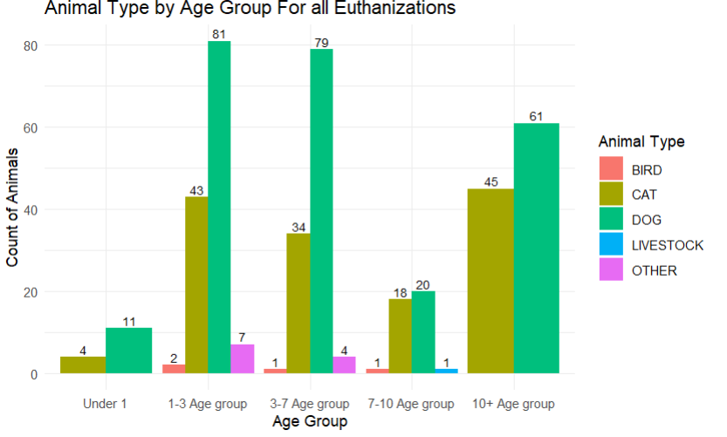
Age Group for all Euthanization Chart: Does age affect the likelihood of Euthanization?​
Dogs account for the highest euthanasia counts across nearly all age groups, especially in the 1–3 and 3–7 ranges.
Cats are the second highest, with notable counts in younger and oldest age groups (1–3 and 10+).
Middle-aged animals (1–7 years) have the highest euthanasia numbers overall compared to very young or older groups.

Slide 8
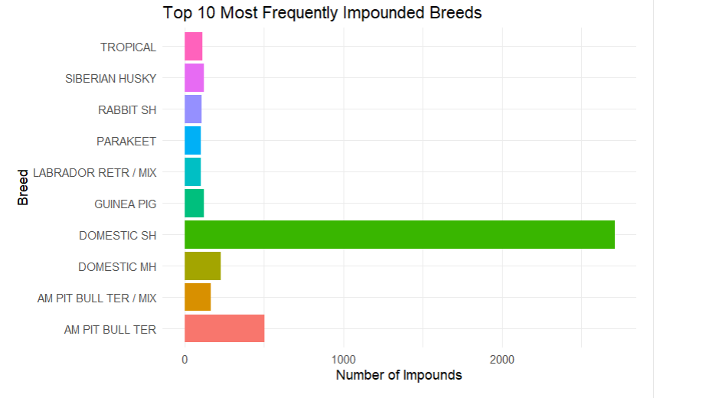
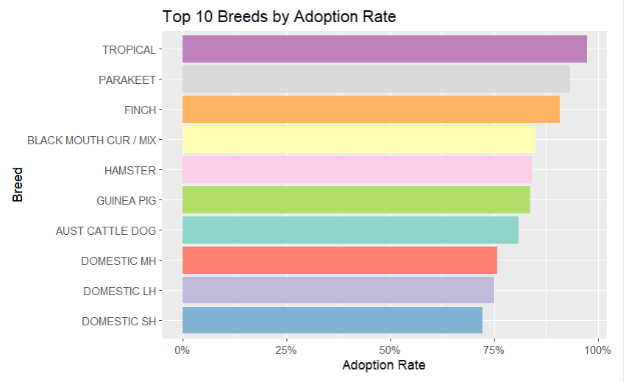
What breeds are most frequently impounded?​ ​
The left graph shows that the most common breed is the domestic shorthair, and the pitbull comes second, and then third, the domestic medium hair.
However, the graph on the right shows the most adopted breeds which the domestic short and medium hair at the bottom of the top 10, and the breed pitbull isn’t seen in the top 10, even though it has high impounded numbers

Slide 9
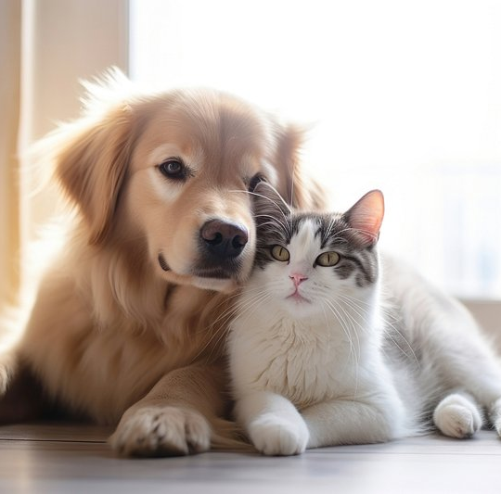
Tableau Dashboard Demo:
The tableau link:
https://public.tableau.com/app/profile/gabriel.castillo.lopez/viz/Update-AnimalShelterTableauMap/AnimalDashboard?publish=yes

Slide 10
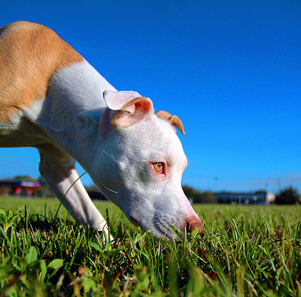
Conclusion:
The animals that are in the 3-7 age range are euthanized at a higher rate than their younger and older counterparts
Dogs are also the number one animal euthanized across all age groups, and cats are trailing behind them.
When the average stay of all euthanized animals is over the time of the average stay of all adopted animals, this is when the euthanized outcome peaks.
Domestic Shorthair cats and Pit Bull Terriers are the most commonly impounded breeds. Pit Bulls are not among the breeds with the highest adoption rates due to their bad image and the jurisdiction against them in some counties.
Hotspots of impounds are Silver Spring, Germantown, and Gaithersburg
This Photo by Unknown Author is licensed under CC BY

Slide 11
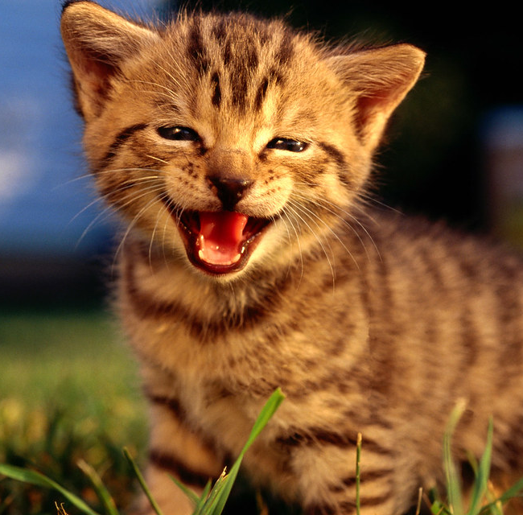
Acknowledgements:
Professor, Lori Perine
Victoria Liu
Maria Anselmo
This Photo by Unknown Author is licensed under CC BY

Slide 12
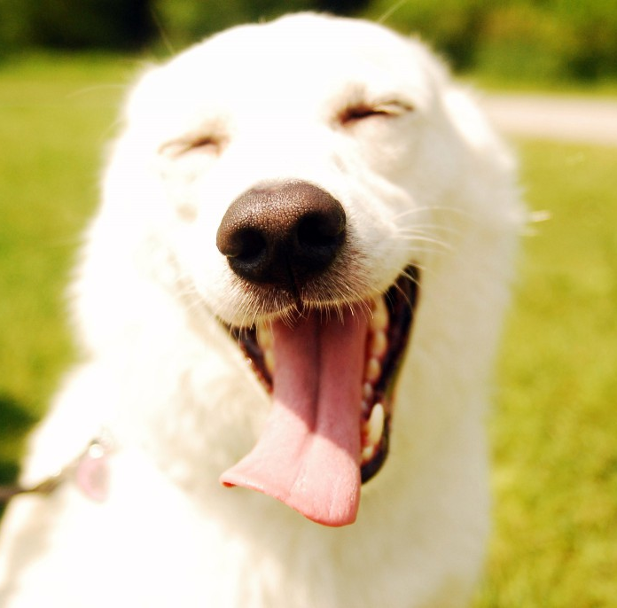
References:
Leybengrub, N. (2025, October 6). Economic hardship drives overcrowding at Maryland’s animal shelters. The Banner. https://www.thebanner.com/community/local-news/housing-insecurity-animal-shelter-overcrowding-NDIV52NSC5DRHKDBUAUYF26HCM/
Maryland demographics: Maryland Business Data. business.maryland.gov. (2025, January 13). https://business.maryland.gov/plan-your-move/demographics/
Montgomery County, M. (2026, May 10). Oas - animal impound: Open Data Portal. OAS - Animal Impound | Open Data Portal. https://data.montgomerycountymd.gov/Public-Safety/OAS-Animal-Impound/6nf9-ewgt/about_data
Montgomery County, M. (2026b, May 10). Oas - Animal Shelter Pathway: Open data portal. OAS - Animal Shelter Pathway | Open Data Portal. https://data.montgomerycountymd.gov/Public-Safety/OAS-Animal-Shelter-Pathway/hsz7-ef2y/about_data
This Photo by Unknown Author is licensed under CC BY-NC-ND

Slide 13

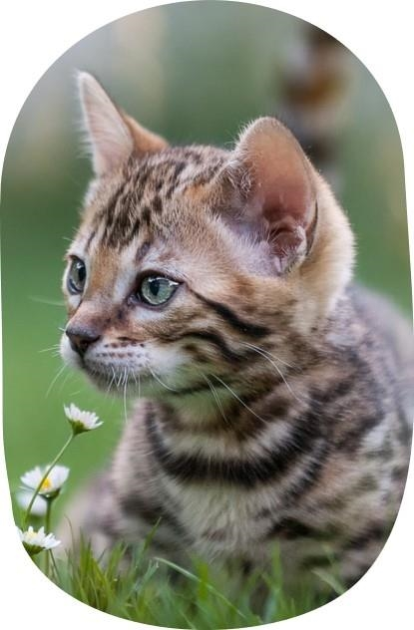
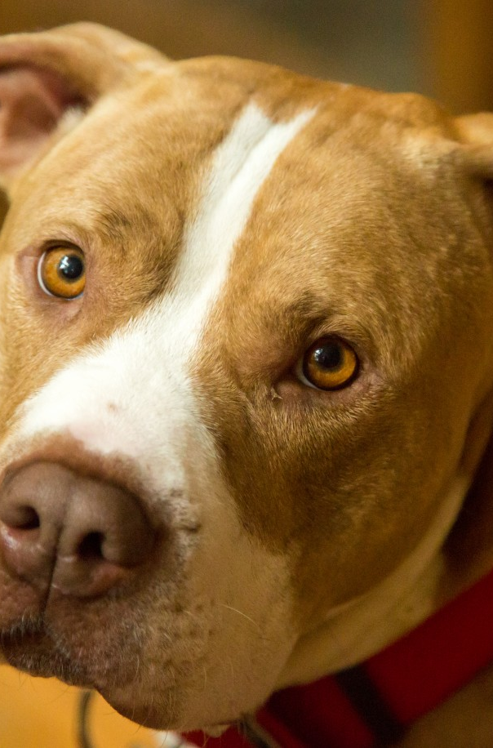

Thank you
Presenter name

